Slide 1
Predicting Stars from Reviews
Edward Lu
INFO 290 Sp 2013

Slide 2
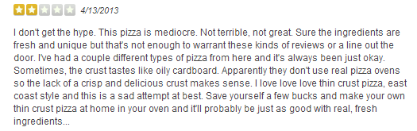
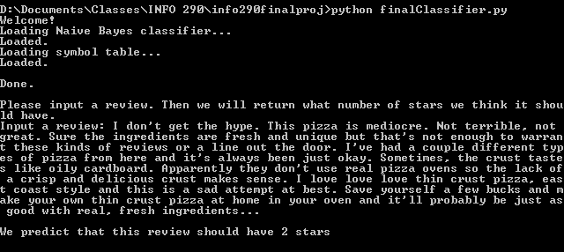
The Problem
?

Slide 3
Motivation
Pretty cool
Objective measure of satisfaction
Easy application to existing reviews without ratings
NLP
Sarcasm detector?

Slide 4
Solution
Yelp Academic Dataset
N-gram hashes
SVM
Decision Tree/Forest
χ² feature selection
Memory errors
Naïve Bayes with unigram feature vectors

Slide 5
